Slide 1

PlanteR-GB
Group 64
Winter is coming….
Zach Lerew, Travis Hodgin,
Max Schmidt, Austin Hodgin

Slide 2
Overview
Problem & Solution
Timeline
Design Specifics
User Interface
Command Line
Web Interface
System Architecture
Hardware
Conclusion
Stretch Goals & Additions

Slide 3
The Problem
NW Winter Conditions
Cold & Dark
Not ideal for plants
Growing Indoors
Controlled Environment
Human Schedules
Current Systems
Expensive
Little Customization

Slide 4
System Solution
RGB LEDs
Variable Colors
Ideal Light Output
Micro Controllers
Customization
Automation
Scheduling
Redundancy

Slide 5
Timeline

Slide 6
User Interface & Web Service
Two different Interfaces
Command Line Interface Asks Questions About
Bed, Zones, Schedule, Profiles
Web interface will have different pages for each section
Bed, Zones, Schedule, Profile
Apache Web Service
Reliable
Process based

Slide 7

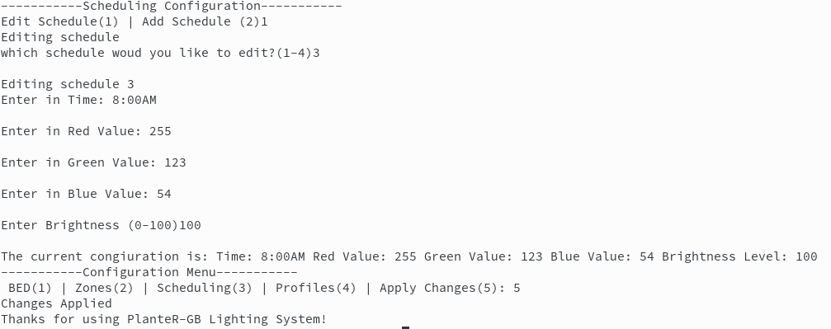
User Interface – Command Line

Slide 8
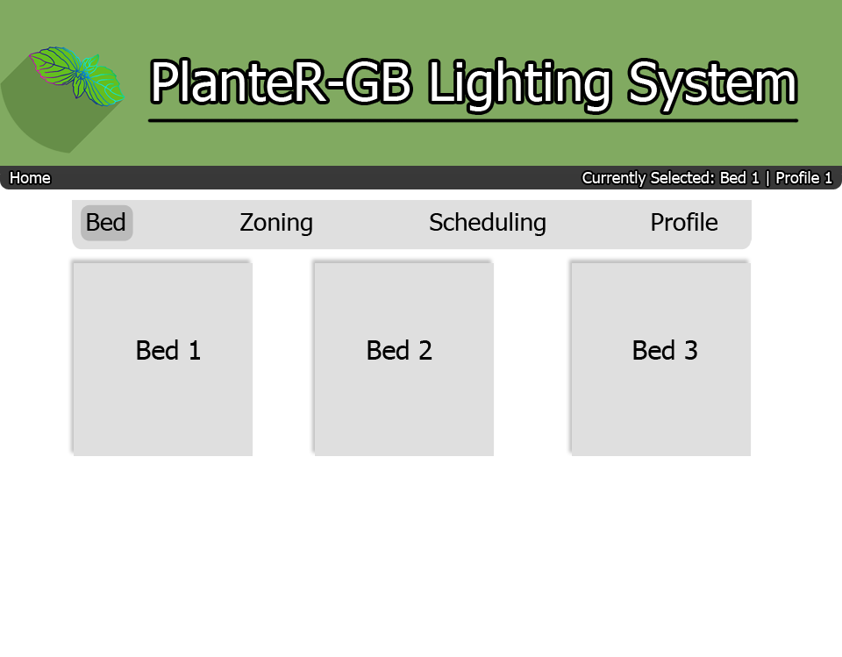
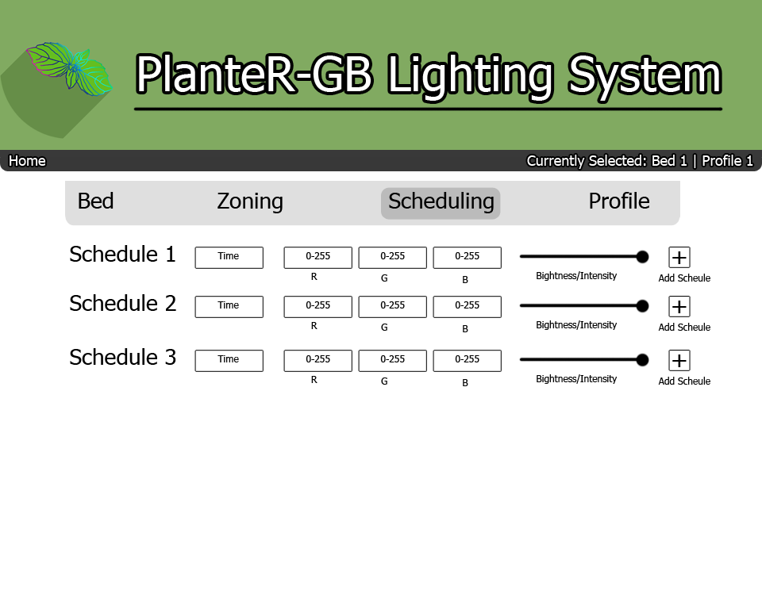
User Interface – Web Interface

Slide 9
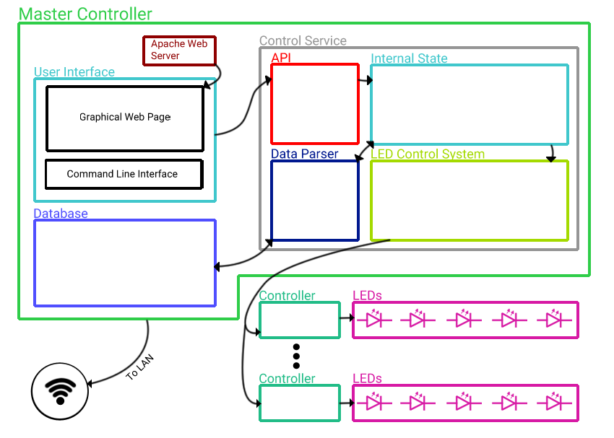
System Architecture

Slide 10
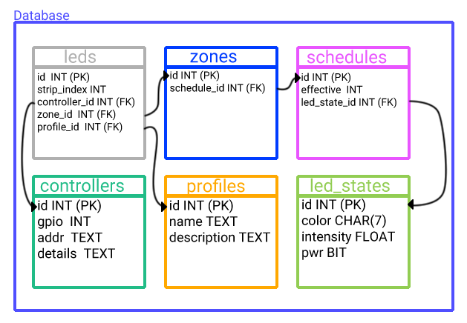
System Architecture

Slide 11
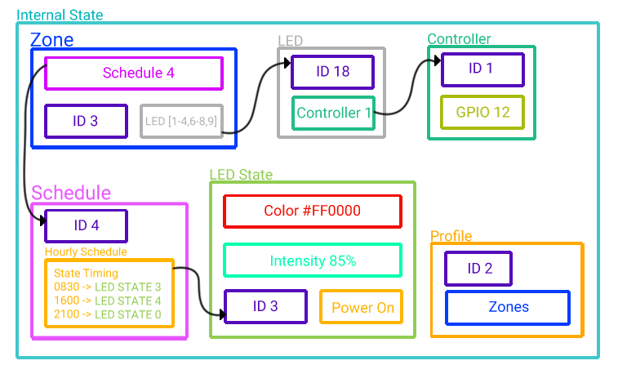
System Architecture

Slide 12
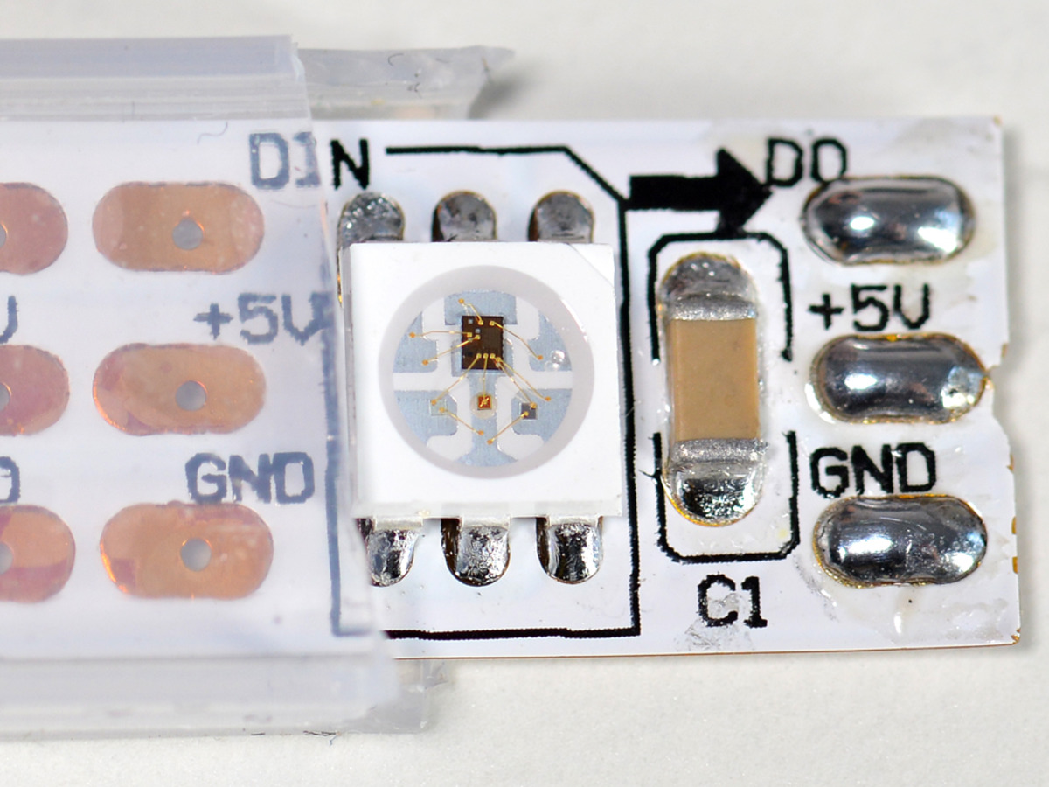
LEDs
WS2812 NeoPixel LEDs
Fully Addressable
Clock based
Supported chosen LED library
Notes:
Travis
12

Slide 13
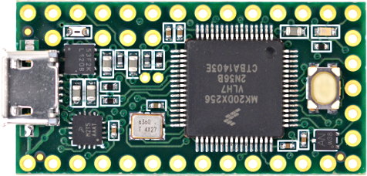
LED controller
Teeny 3.2
Small
Runs Arduino
Single task processor
Running LED control
Notes:
Travis
13

Slide 14
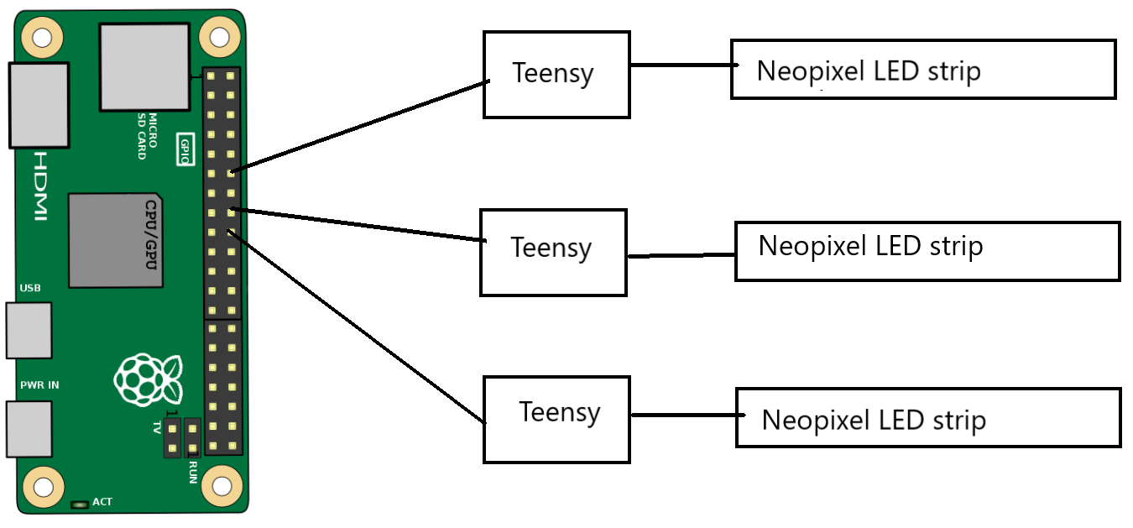
Master Controller
Master Controller: Raspberry Pi
Multi-tasking processor
Wireless and Bluetooth chip
Full Linux OS
Running control and web services
Notes:
Travis
14

Slide 15
LED Library
FastLED
Arduino Library
Supports many different LEDs
Quick development.
Running on the LED controller
Notes:
Travis
15

Slide 16
Conclusion
Goals
Timeline
Web service
Command line
Web Interface
System architecture
Hardware

Slide 17
Stretch Goals
Mobile Wrapper
Custom Enclosure
3D Printed
Vertical Lighting
Additional Sensors & Modules
Soil Moisture
Irrigation
Modular Controllers & Lights
Larger Distributed Systems

